Slide 1
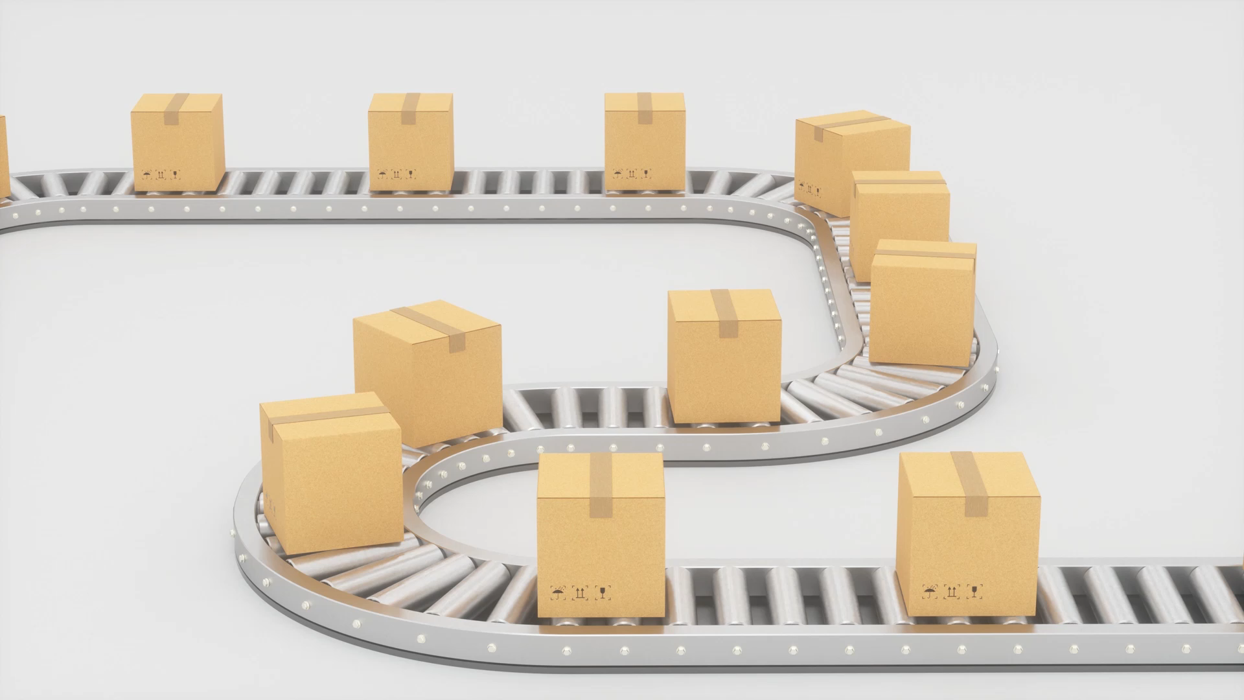
Payment Issues in E-Commerce
Prepared by
Risala Tasin khan
Professor
IIT, JU

Slide 2
Introduction
In e-commerce, the final step before shipment is making payment- i.e. getting the money.
In all three forms of e-commerce, namely B2C, B2B and C2C, we need appropriate methods of payment.
In the real world commercial dealings, there are primarily three ways or modes of payment for goods:
1. Cash payment:
The most common payment scheme between individual customers and merchants is cash, particularly for small value purchases.
2. Credit card/debit card payment:
For larger value purchases, usually a credit/debit card is the one accepted by most merchants. (Credit card, smart card, debit card, ATM card etc. allow consumer to pay without cash. They are online electronic payment media).
3. Cheque payment:
If you have a trusted relationship with a merchant, he would normally accept cheque payment.

Slide 3
What is Electronic Payment
Electronic payment is a system of payments made electronically rather than by paper (e.g. cash, check, voucher etc) between parties using an electronic surrogate which is backed by financial institutions and/or trusted intermediaries.
Electronic payment systems are becoming central to on-line business process.
It helps the customer or user to make online payment for their shopping for faster at lower cost.

Slide 4
Benefit of E-Payment
An online store that accepts e-payment allows you to be open 24/7
This is an important convenience for your customers.
It also means more revenues for you.
It may reduce your overhead costs since you don’t need to hire reception staff and people to take orders.

Slide 5
Demerits of E-payment
E-payment is not always good:
E-payment is more vulnerable to fraud. Neither merchant nor consumer can be fully authenticated.
E-payment maybe costly and challenging to install. For merchants, around 3.5% of purchase price plus transaction fee of 20–30 cents per transaction has to be paid to the issuing bank.
Receiving e-payments causes extra costs since the retailer, for example, must pay a commission to the financial institution processing the card details.
Infrastructure for e-payment is complex and expensive to deploy.
Online payment is hard to implement globally.

Slide 6
Requirements of Payment Systems in E-Commerce
There are several essential and consequential requirements which should be met by e-payment systems. They are:
Payment security which requires that any payment authorization is not tampered with by a hacker on the Internet.
Privacy of transaction requires that third parties do not know for what goods and services one is paying. This also requires that the credit card number (transmitted over the Internet) is not stolen by an eavesdropper.
The payment systems integrity should be assured. In other words, once an agreement is reached between a buyer and a seller, neither can go back on their commitment.
Mutual authentication of the customer and the merchant. In e-payment there is no physical contact between the two parties. There is no signed paper, transaction. Thus, establishing mutual identities is essential.

Slide 7
Continue…
Electronic transactions must be designed to satisfy the following:
Indivisible:
Each payment transaction should be either whole or none. In other words, transactions should not be interrupted in the middle. If some malfunction occurs during a transaction, the whole transaction should be aborted and the state restored to the initial state.
Isolated:
Each transaction should be independent of others.
Agreed:
Both parties involved in the transaction should mutually agree on the terms and conditions.
Reversible:
If after conclusion of a transaction an error is found or if it is found that terms and conditions are not fully met, one should be able to reverse the payment and go to the initial state. For example, in credit card payment, if a customer is dissatisfied due to a valid reason, the card company should credit the payment back to the customer and debit it from the merchant's account.

Slide 8
Crucial Factors or Features of Payment Methods
Anonymity
It means whether the payment method is anonymous.
Security
The payment method should be secured.
Overhead cost:
The overhead cost of processing a payment should be low.
Transferability:
It means whether a payment can be carried out without the involvement of a third party. It should be transferable.
Divisibility:
It means whether a payment can be divided into arbitrary small payments whose sum is equal to the original payment.
Acceptability:
It means whether the payment method is supported globally or locally.

Slide 9
Cash Versus E-Money (E-Cash)
Cash or money is-
- the most common anonymous form of payment. Anyone can walk up, purchase an item, and pay in cash without having to show identification.
- a medium of exchange to simplify transaction defined by a national authority to represent value.
- a standard of value (to make it easier to decide on the worth of goods)

Slide 10
Continue..
Electronic money or e-money or e-cash-
-Electronic money, or e-money, is the money balance recorded electronically on a stored-value card.
-These cards have microprocessors embedded which can be loaded with a monetary value.
- E-money does not use paper documents or coins.
- It can serve as a substitute for government-issued physical currency.
- It allows consumers to pay for goods without cash.
- It includes credit card, smart card, debit card, ATM card etc.
- It allows a person to pay for goods or services by transmitting a number from one computer to another.

Slide 11
Merits/ Features of Cash
1. Convenience:
– It is easy to use, easy to carry, and easy to handle in small quantities.
2. Wide acceptance:
– The U.S. dollar is the most widely accepted paper currency in the world because of its stability and durability.
3. Anonymity:
– No identification is needed to pay in cash.
4. No cost of use:
– For customers who use cash, there are no hidden costs, overhead, or processing fees. For the merchant, it means transporting cash to the bank for safekeeping on a daily basis.
5. No audit trail:
– Lack of traceability means you can do what you want with your cash. In countries where trust in the currency, the banking system, or the government is in question, cash is used to buy all kinds of products, including homes, automobiles, and other big-ticket items. Trust is the basis of electronic payment systems.
6. Portability:
– Cash is portable, requires no authentication, and provides instant purchasing power.

Slide 12
Demerits of using Cash:
Cash is- - easy to loose/ easily stolen.
- difficult to trace.
- cumbersome to carry (when amount is large and hence more space and more security measures are needed).
- time consuming to count, organize and manage.

Slide 13
Key Features or characteristics of E-Money
E-money is becoming more attractive for conducting business in online. It offers several features:
a. Speed of transfer
b. Ease of handling, i.e. easy to count, organize or manage
c. Convenience, since safety of not having to carry cash
d. Ease of trace
e. Universally accepted
f. Transferable electronically
g. Private (no one except parties know the amount)

Slide 14

Types of E-Money
Identified e-money:
– Identified e-money contains information revealing the identity of the person who originally withdrew the money from the bank. Also, in much the same manners as credit cards, identified e-money enables the bank to track the money as it moves through the economy
– This type of money contains information that makes it possible to identify the person who withdrew the money from the bank. The process generates an audit trail.
Anonymous e-money:
This e-money contains no information, so it is not possible to identify the person who withdrew the money from the bank, i.e. anonymous money cannot be traced. It is like paper money and leaves no audit trail.

Slide 15

Continue…
Online e-money:
It means, each transaction is verified and approved by the issuing institution (such as bank) before payment is made.
Offline e-money:
This type of e-money requires no validation.
An offline transaction, also known as a signature debit transaction, is a payment method that uses a debit card to transfer funds from a checking account to a merchant across a digital credit card network

Slide 16
Requirements for Internet-based payments
(1) The ACID test
It is a set of properties in a money transfer that include:
- Atomicity
A transaction must occur completely or not at all.
- Consistency
All parties involved in the transaction must agree to the exchange.
- Isolation
Each transaction must be independent of any other transaction and be treated as a stand-alone episode.
- Durability
It must always be possible to recover the last consistent state or reverse the facts of the exchange.

Slide 17
Continue…
(2) ICES test
It is also a set of properties of a money transfer that include:
- Interoperability
Ability to move back and forth between different systems.
- Conservation
How well money holds its value over time and how easy money is to store and access.
- Economy
Processing a transaction should be inexpensive and affordable.
- Scalability
It refers to the ability of the system to handle multiple users at the same time.

Slide 18
Continue…
In addition to ACID and ICES tests, the important properties required for an Internet-based payment system are:
1. Acceptability:
For electronic payment to work, the system must be widely accepted and acceptable to merchants. Merchants must have the technical ability and the processes to expedite a sale without delay.
2. Ease of integration:
The website interface must be effective and well integrated into the total network environment. It also should be independent of any other payment instrument.
3. Customer base:
Enough users and enough traffic must be present to justify investing in the electronic payment mechanism.
4. Ease of use:
The use of payment system should be as easy as pressing a button on the screen.
5. Ease of access:
The access to the payment system should be very easy. Users don’t like to wait.

Slide 19

Electronic Payment Media

Slide 20
Some Keywords
Money Laundering:
Money laundering is the process whereby the origin of dishonest (or dirty) money generated by criminal activities and/or illegally obtained money is concealed so that it appears to come from a legitimate source and cannot be easily traced back to their legal origin.
In the method of money laundering; money is invested in such a way that even the investigating agencies can’t trace the main source of wealth.
The person who manipulates this money is called "launderer".
Steps involved in Process of Money Laundering:
Placement
Layering
Integration

Slide 21
Money Laundering (Cont..)
Placement:
The first step in this process is the investment of black money in the market.
The launderer deposits the illegal money through different agents and banks in the form of cash by having a formal or informal agreement.
Layering:
In this process, the launderer hides his real income by making foul play.
The launderer deposits funds to investment instruments such as bonds, stocks, and traveler's checks or in their bank accounts abroad.
This account is often opened in banks of those countries which do not reveals the details of their account holders.
So in this process the ownership and source of money is disguised.
Integration:
The final stage at which the ‘laundered’ property is re-introduced into the legitimate economy OR Returning the money back into the financial world as legal money.

Slide 22
Examples of Money Laundering
There can be several ways to do money laundering, but the most popular is the establishment of the fake companies which is also known as the "shell companies".
‘Shell Company’ acts like a real company but in reality this company does not exist in the real world and no production take place in such companies.
Actually these shell companies exist only on paper, not in the real world.
But the launderer shows large transactions in these Shell Company’s balance sheets.
He takes loan in the name of these companies, gets tax exemption from the government, does not fill income tax returns and through all these fake activities, he accumulates a lot of black money.
If investigating agencies or regulatory bodies want to check financial records, false documents are shown to confuse them.
In another way, money laundering takes place when the launderer deposits his black money in the foreign banks.
These foreign banks do not share customer’s account information with any country.
Like banks in the Switzerland do not share account information where large numbers of Indians have deposited their black money.

Slide 23
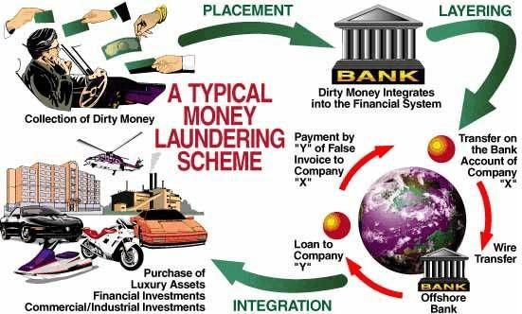

Slide 24
Continue..
Biometrics
It means the use of a body part such as the thumb (fingerprint), retina, iris, facial analysis etc. or the use of behavioral characteristics such as voice pattern, hand geometry-vein pattern, hand-written signature etc. to authenticate identity. It may be used as a replacement for computer passwords.
With the proliferation of credit cards and other payment media in e-commerce, one big headache a customer will encounter is keeping track of passwords for different cards. A single card could replace all these passwords and be activated simply by pressing thumb on the card. The card would carry a digital fingerprint.
Many ATM machines scan the customer’s retina for a few seconds in lieu of traditional password.

Slide 25
Continue…
Credit Card Associations
Visa, MasterCard, Discover, American Express etc are some credit card associations. A credit or debit card will use a merchant account affiliated with one or more traditional credit card associations.
Point Of Sale (POS)
It is the location at which the sale or transaction takes place, i.e. the point at which goods and services are received in exchange for payment.
POS (Point-of-Sale) Terminal
It is a computerized device (that records items purchased and calculate the total amount due for each sale) used for verifying and processing credit card transactions at the point of sale by communicating transaction information to a remote central computer of a bank connected directly via telecommunication lines or through a network. If the credit card is available, the merchant can swipe the card through the terminal. A POS terminal has the capability to read and change information on a card to assist in or complete a retail transaction

Slide 26
Continue…
Automated Teller Machine (ATM)
It is a cardholder-operated terminal that performs basic teller functions, such as accepting deposits, cash withdrawals, account transfers, loan payments, and account balance enquiries. This machine reads ATM card or debit card, deducts funds after withdrawal from a customer’s checking account.
Automated Clearing House (ACH)
It is a service that electronically processes payments of funds and government securities among institutions and businesses. ACH processes large volumes of credit and debit transactions in batches. ACH credit transfers include direct deposit, payroll and vendor payments. ACH direct debit transfers include consumer payments on insurance premiums, mortgage loans, and other kinds of bills

Slide 27
Continue…
E-Wallet
It is an electronic payment system that operates like a carrier of e-cash and other information in the same way a real-world wallet carries real cash and various IDs.
The aim of the e-wallet is to give the shoppers a single, simple, and secure way of carrying currency electronically. As a form of electronic payment, trust is the basis of the e-wallet. The procedure for using an e-wallet is easy:
(1) Decide on an online site where you would like to shop.
(2) Download a wallet from the merchant’s website where you intend to shop. The special form requires the buyer to fill in some personal information.
(3) Fill in the personal information such as your credit card number, name, address, and phone number, and where merchandise should be shipped.
(4) When you are ready to buy, click on the wallet button and the buying process is fully executed. Billing information is filled out automatically. Another option is to drag information out of the wallet and drop it into the online form

Slide 28
What is Credit Card
A credit card (also called charge card) is a small plastic card with a coded magnetic stripe on the back that can be read at the point of sale (POS terminal).
Credit amount and interest rate are set by the lender and are determined by the borrower's income and credit report. Generally, different credit limit is established for different cardholder. It has a spending limit based on a user’s credit history.
A credit card requires the user to have an account on a server or at an issuing bank equipped with the proper Internet connection. Whenever you use a credit card, you are borrowing money from someone else to purchase something. A credit card is then, in essence, a loan.
The credit card company is lending you money in order to make your purchase, for which you are going to be charged interest on later (assuming you don’t pay the total balance within a predetermined period).

Slide 29
Parties Involved in a Credit Card Transaction
Four parties are involved in credit card transaction:
(i) the cardholder (customer),
(ii) the merchant (who accepts credit cards (typically a merchant would accept credit cards of several companies such as Visa, Master card, etc.),
(iii) Issuer or issuing bank, the bank that issues the credit card to customers, guarantees payment to merchants and collects bills from its customers. The customer's bank collects an annual fee from its customer and also a large monthly interest on outstanding overdue payments. Monthly interest may range from 1.5 to 3% on overdue bills.
(iv) Acquirer or acquiring bank, the merchant's bank which establishes an account with a merchant, validates card information presented by a merchant and approves sales based on a customer's credit status. The acquirer normally charges a commission of around 2% on each sale from the merchant.

Slide 30
Manual Credit Card Transaction
Credit cards are issued after an account has been approved by the credit provider, after which cardholders can use it to make purchases at merchants accepting that card.
Manual credit card transactions are carried out as follows:
1. A customer presents a credit card to a merchant after purchasing items from a store and agreeing to pay the billed amount.
2. The merchant swipes the card using a tele terminal which reads the data contained in the magnetic strip of the card and enters the transaction amount. The card data and amount are transmitted to the acquirer via a private communication line.
3. The acquirer's computer forwards the data to the bank which issued the card. The bank checks the validity of the card, credit available on the card and approves transaction provided the card and credit are OK.
4. If all are OK, the acquirer authorizes sale and sends approval slip to the merchant which is printed duplicate at merchant's terminal. The acquirer also credits the merchant's account with sale amount minus commission. The acquirer collects the amount from customer's bank.

Slide 31
Continue…
5. The merchant requests the customer to sign the approval slip, compares the signature with that in the card and if OK delivers the goods.
6. The bank sends a monthly statement to the customer and collects the outstanding amount.

Slide 32
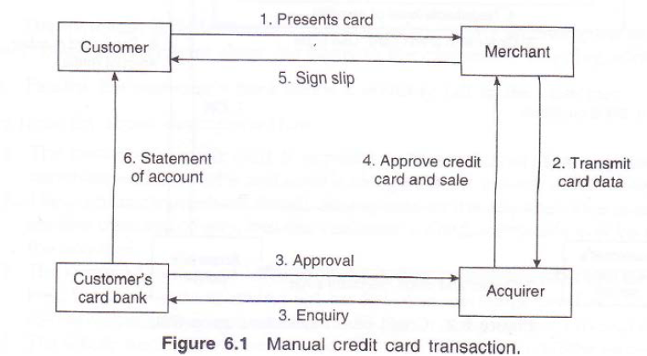

Slide 33
Continue…
In manual credit card transaction, there is physical proximity of a customer with a merchant and the transaction is validated after obtaining the signature of the customer on the payment slip.
In e-commerce there is no physical contact between the merchant and the customer and it is impossible to verify the physical signature. But, it is necessary for the merchant to verify that a customer is genuine and the customer to be assured that he or she is not dealing with a fake merchant.
- Thus, a customer would be reluctant to disclose his or her credit card number using the Internet as the merchant may be fake or the number may be stolen by eavesdroppers on the Internet.
- Furthermore, if the merchant is careless, a hacker may access his or her database and steal credit card numbers.
An ideal protocol named SET (secure electronic transaction) would be one in which the credit card number is not revealed to the merchant but only to the bank approving it. The approving bank need not know what a customer bought but only the amount of payment to be approved (to protect customer's privacy).

Slide 34
Credit Card Payment using Secure Socket Layer
SSL, short for Secure Socket Layer, is a widely used security protocol developed in 1995 by Netscape Communication Corporation, the then-dominant browser vendor.
This protocol is designed to provide security (e.g. data encryption, server authentication, and message integrity) for the transmission of private or sensitive data over the Internet.
SSL encrypts the data (like credit cards numbers) and other personally identifiable information while it is being transmitted over the Internet which prevents the "bad guys" (unauthorized people) from stealing your information for malicious intent. The encryption is done in the background, without any interaction from the user, so there is no password to enter or remember.
This protocol is used for establishing a secure connection between the server and the browser. It controls the communication between the SSL server and the browser.

Slide 35
Continue…
SSL is called secured socket, because it uses a "secure socket" or port for transferring encrypted information between the server and the browser.
SSL is used by all URLs that begin with https. SSL is used by all of Netscape’s browser products, as well as Microsoft’s Internet Explorer 3.0 or higher. In addition, it is built into products such as Apache and Internet Information Server. Most browsers and computers today can exchange secure transactions using this protocol across the Internet.
One requirement for proper use of SSL is that the merchant’s Web server and the customer’s Web browser must use the same security system.

Slide 36
Credit card payment using SSL
Step 1:
A client accesses the web site of a merchant by using its URL. For example, a request to buy from a hypothetical company Khan Bookstore will look like https://www.KhanBookstore.com.
Step 2:
The client examines the catalogue of books, and selects the books he or she wants to buy. The selected items are placed in a virtual shopping cart assigned by the merchant's server.
Step 3:
The book store's server examines the shopping cart assigned to the client and prepares an invoice including all taxes and shipping charges. This invoice is displayed in the client's browser along with a form requesting credit card information and shipping instructions.

Slide 37
Continue..
Step 4:
The server negotiates with the client's computer level of security. If the client's browser does not have SSL security, the transaction cannot proceed as the credit card number will be exposed. A warning is displayed in the client's browser.
Step 5:
' Assuming client's browser is SSL compliant, the client now types:
https://www.KhanBookstore.com
https ensures that the data typed by the client is encrypted with a session key and sent to the web site KhanBookstore.com. Thus, the credit card number and the shipping address are encrypted. As the session" key is a random number and is used only for one session, eavesdroppers cannot use it even if they find it.
Step 6:
The merchant decrypts the data.
The credit card number, the amount to be paid by the customer, invoice details along with the merchant's, public key certificate, is sent to the acquirers (merchant’s bank) by the merchant encrypted using the acquirer's public key. The-merchant also digitally signs the data. The details of invoice are sent to resolve any disputes between the customer and the merchant at a later date.

Slide 38
Continue…
Step 7:
The acquirer checks with the bank which issued a customer's card its validity, the customer's balance in this account and the merchant's digital signature. The acquirer will transfer the amount electronically to the merchant's bank and collects it from the customer's bank provided the customer's bank approves the transaction. It then sends authorization to the merchant to accept the sale. This authorization is encrypted with the merchant's public key.
Step 8:
The merchant accepts the customer's order and sends an encrypted receipt to the customer. Later the merchant ships the items to the customer's shipping address.
Step 9:
Finally, the customer's bank sends a monthly bill to, the customer.

Slide 39
Some Important Notes to be Pointed
1. Using SSL, the customer's credit card is exposed to the merchant. It is expected that the merchant will encrypt it and store it along with the -invoice in his or her database.
2. The customer's purchase-details are exposed to the acquirer.
3. The major advantage of https protocol is that a customer need not have a public key. Sensitive data is encrypted by SSL and customer need not worry about eavesdroppers stealing his or her credit card number during Internet transaction.
4. The whole transaction is automated. The customer, carries out the entire operation by clicks of the mouse button. Picking the encryption key, encryption; merchant authorization, etc., are all done by the https software (which has SSL underneath it).
5. If a customer uses http protocol instead, of https, he or she will be warned about the website not being secure and in many systems the transaction will not be accepted.

Slide 40
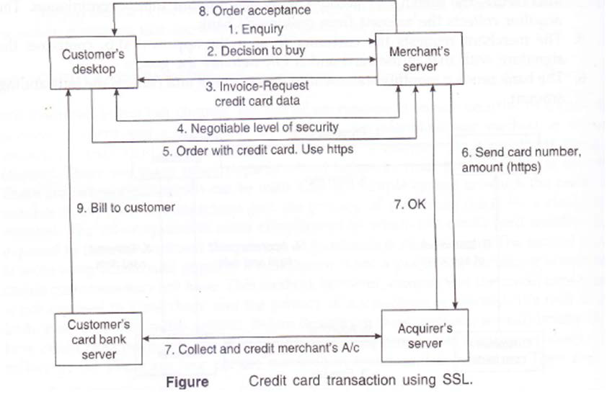

Slide 41
Secure Electronic Transaction (SET) Protocol
The Secure Electronic Transaction, abbreviated as SET, is a protocol designed specifically to secure credit card transactions over the Internet. It will ensure that credit card and associated payment order information travels safely and securely between the various involved parties on the Internet.
The two leading bankcard associations Visa International and MasterCard International with the cooperation from Microsoft, Netscape, IBM and many other leading technology companies around the world developed SET as a common standard to process card transactions on the Internet in 1996.

Slide 42
SET (Continue…)
The SET protocol is designed to operate both in real time, as on the World Wide Web, and in a store-and-forward environment, such as e-mail.
Like other encrypting protocols, SET uses a combination of public and private key cryptography to establish involved parties’ identity and to ensure payment data security.
SET employs digital signatures to enable merchants to verify the identity of buyers. It also protects buyers by enabling their credit card number to be transferred directly to the credit card issuer for verification and billing without revealing the number to the merchant.

Slide 43
Phases of SET Protocol
SET protocol has four phases:
Initiation:
First, the cardholder sends a purchase initiation request to the merchant for initializing the payment. Then the merchant returns a response message to the cardholder.
Purchase:
In the second phase, the cardholder sends the purchase order together with the payment instruction to the merchant.
Authorization:
In the third phase, the merchant obtains the authorization from the issuer via the payment gateway.
Capture:
Finally, the merchant requests a money transfer to its account.

Slide 44
Credit card transactions using SET protocol
The SET protocol involves four parties:
(i) the cardholder (customer),
(ii) the merchant,
(iii) the bank that issues the credit card (Issuer or issuing bank),
(iv) the merchant's bank (Acquirer or acquiring bank).
Credit card transactions using SET protocol are carried out as follows:
1. The customer and the merchant negotiate a transaction:
The customer's PC and merchant's server exchange their certified public keys.
The merchant also sends acquirer's public key to the customer.
They also negotiate the type of public key encryption and the hashing function to be used.

Slide 45
Continue..
2. The customer sends the order and payment information to the merchant:
The customer browses the merchant's web site. He/she goes through the various goods and services on display and decides to buy something.
Then, he/she fills the purchase order, amount payable and credit card number in his or her PC.
SET Software in customer’s PC creates two messages:
Purchase Order and Amount (POA), which is encrypted using merchant's public key and
Credit Card number and Amount (CCA), which is encrypted with acquirer's public key. This prevents the merchant from peeking at the credit card number or the bank from peeking at the order information.

Slide 46
Continue…
The software now computes a hash of the POA (termed as POH) and a hash of the CCA (termed as CCH).
It then signs POH and CCH jointly with the customer's private key. This creates a "dual signature" DS that allows both merchant and merchant's bank to validate the integrity of POA and CCA.
The customer sends POA, CCH, POH and DS to the merchant. The merchant verifies signature and proceeds further if the signature is OK.
3. The merchant forwards encrypted CCA, POH and DS to the acquirer.
4. The acquirer forwards it to the customer's bank.
5. The customer's bank checks the validity of the card (i.e., credit card number, credit available and the dual signature of the customer). The result of verification is sent to the acquirer.
6. The acquirer in turn approves or rejects the transaction and informs the merchant. It credits the merchant’s account with purchase amount minus commission.
7. The merchant approves the order and sends to the customer the shipping details.
8. At the end of the month, the issuing bank (customer’s bank) sends a consolidated bill to the customer.

Slide 47
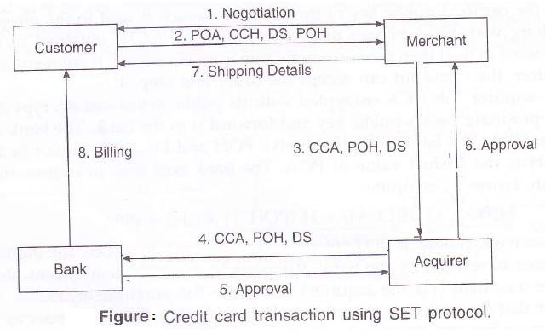

Slide 48
Main Features of SET
Dual signature (DS) scheme is an innovation in SET protocol.
Customer’s credit card number is not revealed to a merchant. It is revealed only to the acquirer who authorizes payment.
Purchase invoice details are not revealed to the acquirer. Only the credit card number and total amount are revealed to him
Purchase invoice and credit card number is digitally signed by the customer. In case of a dispute, an arbitrator can use this to settle the dispute.

Slide 49
Dual Signature (DS)
SET protocol depends on an innovation called dual signature whose main purpose is to give the merchant only the purchase order and amount without disclosing the credit card number, and give to the acquirer only the credit card number and the amount without disclosing the purchase details.
Steps to be followed for creating dual signature in SET protocol are:
1. Customer purchase information has 3 parts-
Purchase Order (PO)
Credit Card Number (CCN)
Amount to be paid
Merchant should know (PO + Amount)=POA
Acquirer should know (CCN+Amount)=CCA
2. Hash POA using standard Hash algorithm such as RSA’s MD5. Call it POH.
3. Hash CCA using MD5. Call it CCH.

Slide 50
DS (Continue…)
4. Concatenate POH and CCH. Call it (POH||CCH)
5. Hash (POH||CCH) giving PPH
6. PPH is encrypted using private key of customer. This is customer’s digitally signed purchase order called dual signature (DS). It is called so, since a private key is used to sign two separate digests concatenated together. It is sent to merchant by customer.

Slide 51
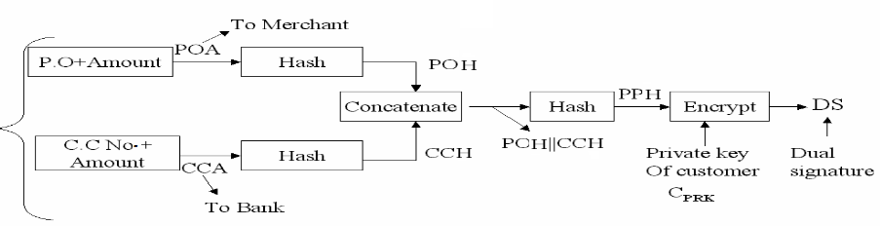
Figure: Duel Signature System

Slide 52

Electronic Fund Transfer (EFT)
If Alice issues a cheque favoring Bob, it will be written on a cheque in Alice's bank (say X). Bob will deposit the cheque in his bank (say Y).
Before Bob's account (in bank Y) can be credited, the bank Y should check with Alice's bank X whether she has enough money in her account. If the bank X approves, then Alice's account in bank X will be debited and Bob's account in bank Y will be credited.
This process of cheque clearance has been automated and is called Electronic Funds Transfer (EFT).
In order to implement electronic funds transfer, the following requirements have to be met:
An Automated Clearing House (ACH) should work as an intermediary to negotiate transfer of funds when cheques are used.
All banks should use ACH and become its members.
There should be a secure electronic communication channel between each bank and the ACH.

Slide 53
Clearance of Cheques in EFT
In electronic fund transfer, a cheque can be cleared either by Automated Cheque Clearance or Electronic Clearing Service (ECS).
We provide here the cheque clearance method using the first model.
We will assume that A and B are the two parties involved and that A has an account with bank X and B with bank Y. As an intermediary, ACH (automated clearing house) maintains balances kept by all its member banks.

Slide 54

Clearance of Cheques in EFT
The steps are given below:
A sends a cheque drawn on his bank X to B.
B deposits the cheque in his bank Y.
Y will send the cheque to ACH.
ACH has an automated system to sort cheques based on unique bank code. Based on X's code, it sends a query to bank X whether the amount can be paid (A's physical cheque should be forwarded to X by ACH).
If the reply from bank X is yes, ACH debits X's account and credits Y's account with it.
ACH intimates bank Y that the cheque is cleared.
Bank Y credits B's account with the amount specified in the cheque and updates B's account.
Bank X debits A's account by the amount specified in the cheque.

Slide 55
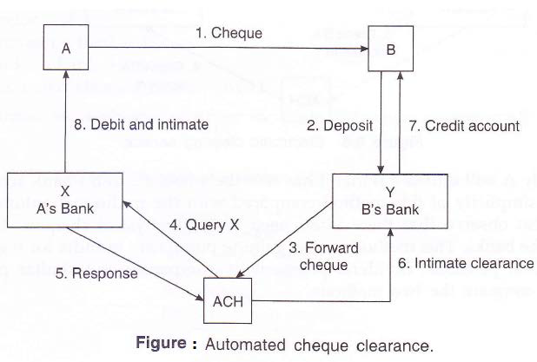

Slide 56
Electronic Clearing Service
In the Electronic Clearing Service (ECS), the following steps are followed:
When A wants to send a specified amounts to B:
A requests B to send the unique 9-digit code of B's bank Y and B's account number in Y in which the money due has to be credited.
2. A sends an intimation to its bank X to debit its account by the specified amount and credit it to B's account with bank Y.
3. Bank X requests ACH to debit its account with ACH by S and credit it to Y's account. It also requests ACH to advise Y to credit B's account by the specified amount S.
4. ACH requests Y to credit B's account with the specified amount S.
5. Y intimates B that the amount from A has been credited.
Normally A will intimate B that it has sent the amount S to B's bank account with Y.

Slide 57
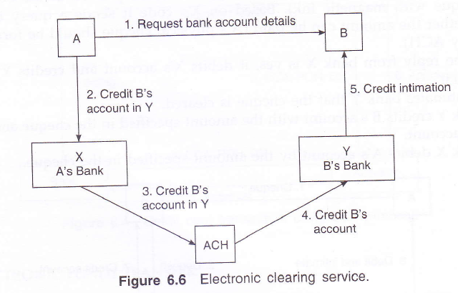

Slide 58
Real Time Gross Sattlement (RTGS)
Real-time gross settlement is the continuous process of settling interbank payments on an individual order basis across the books of a central bank.
This system's process is opposed to netting debits with credits at the end of the day.
Real-time gross settlement is generally employed for large-value interbank funds transfers.
RTGS systems are increasingly used by central banks worldwide and can help minimize the risks related to high-value payment settlements among financial institutions.

Slide 59
How RTGS Works
When you hear the term real-time, it means the settlement happens as soon as it is received.
So, in simpler terms, the transaction settles in the receiving bank immediately after it is transferred from the sending bank.
Gross settlement means transactions are handled and settled individually, so multiple transactions aren't bunched or grouped together.
This is the basis of a real-time gross settlement system.
An RTGS system is generally used for large-value interbank funds transfers operated and organized by a country’s central bank.
These transfers often require immediate and complete clearing.
As mentioned above, once transactions are settled, they cannot be reversed.

Slide 60
RTGS vs EFT
Parameter of Comparison | Electronic Fund Transfer (EFT) | Real Time Gross Settlement (RTGS)
Amount Limit | There is no limit – for minimum amount – Maximum amount limited to per transaction is Rs.50000 within India | The minimum amount to be remitted through RTGS is Rs 2 lakh
Settlement | Transactions are processed and settled in batches, at the end of the day | Transactions are processed and settled in real time and on gross level
Money transfer Suitable for | Usually small value transaction | High value transaction
Processing | Compare to RTGS slow | Fast as it settled in real time
Business Hours | On all working days except bank holidays, 12 settlement in a working day | On all working days except bank holidays, Continuous settlement.

Slide 61
ELECTRONIC CHEQUE PAYMENT
In B2B e-commerce the purchaser and the vendor normally have mutual trust before negotiating a purchase. The amounts involved is also quite large.
Thus, payments are normally made by cheque. Thus, we have to find an electronic equivalent of a physical cheque and payment scheme to mimic the manual scheme. We thus need banks and ACH to accept electronic cheques in addition to physical cheques. Assuming this condition is satisfied, we will describe a method.
Before electronic cheque payment system is implemented, the following conditions must be satisfied:
Both businesses must have certified public keys and must be able to digitally sign e-cheques.
2. All banks and ACH must have public key certificates and must be able to digitally sign documents using a common agreed hash function.

Slide 62
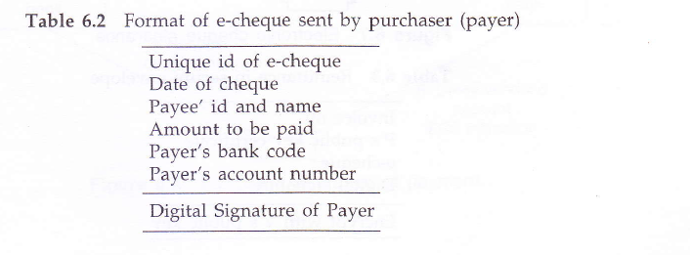
There are five parties involved in the transaction.
1. Purchaser - P
2. Vendor - V
3. Purchaser's bank - PB
4. Vendor's bank - VB
5. Automated clearing house – ACH
One format for e-cheque is given in Table 6.2 which contains all the essential
Information.

Slide 63
The steps followed in e-cheque payment are as follows (See Figure 6.7).
1. The purchaser (P) and Vendor (V) exchange their public key certificates and their respective bank details.
2. The Vendor (V) sends an invoice with payment request to the purchaser (P) encrypted with P's public key.
3. The purchaser decrypts the invoice and payment request. P checks validity of request and if OK writes an e-cheque (Table 6.2). The e-cheque along with invoice number and P's public key certificate are digitally signed and the digital signature is attached. This information is encrypted with V's public key and sent to the vendor (See Table 6.3). (This is called secure envelope).

Slide 64
4. The vendor verifies the signature and appends to this information an-endorsement, his public key certificate and digitally signs all the above information. This is encrypted with the public key of the vendor's bank and sent to it (See Table 6.4).
5. The vendor's bank decrypts the information. It takes out the e-cheque, encrypts it with ACH's public key and sends it to ACH.
6. ACH decrypts it, forwards it to the purcahser's bank encrypting with PB's public key.
7. PB decrypts it and authorizes payment if all OK.
8. ACH debits PB's account and credits VB's account. It informs VB that the e­cheque is cleared.
9. VB credits vendor's account.
10. PB debits purchaser's account.

Slide 65
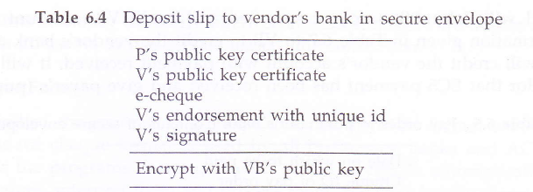

Slide 66
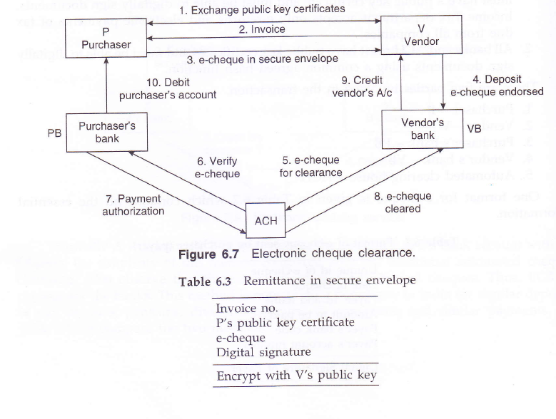
Notes:
RTGS/MPSB/BFTN

Slide 67
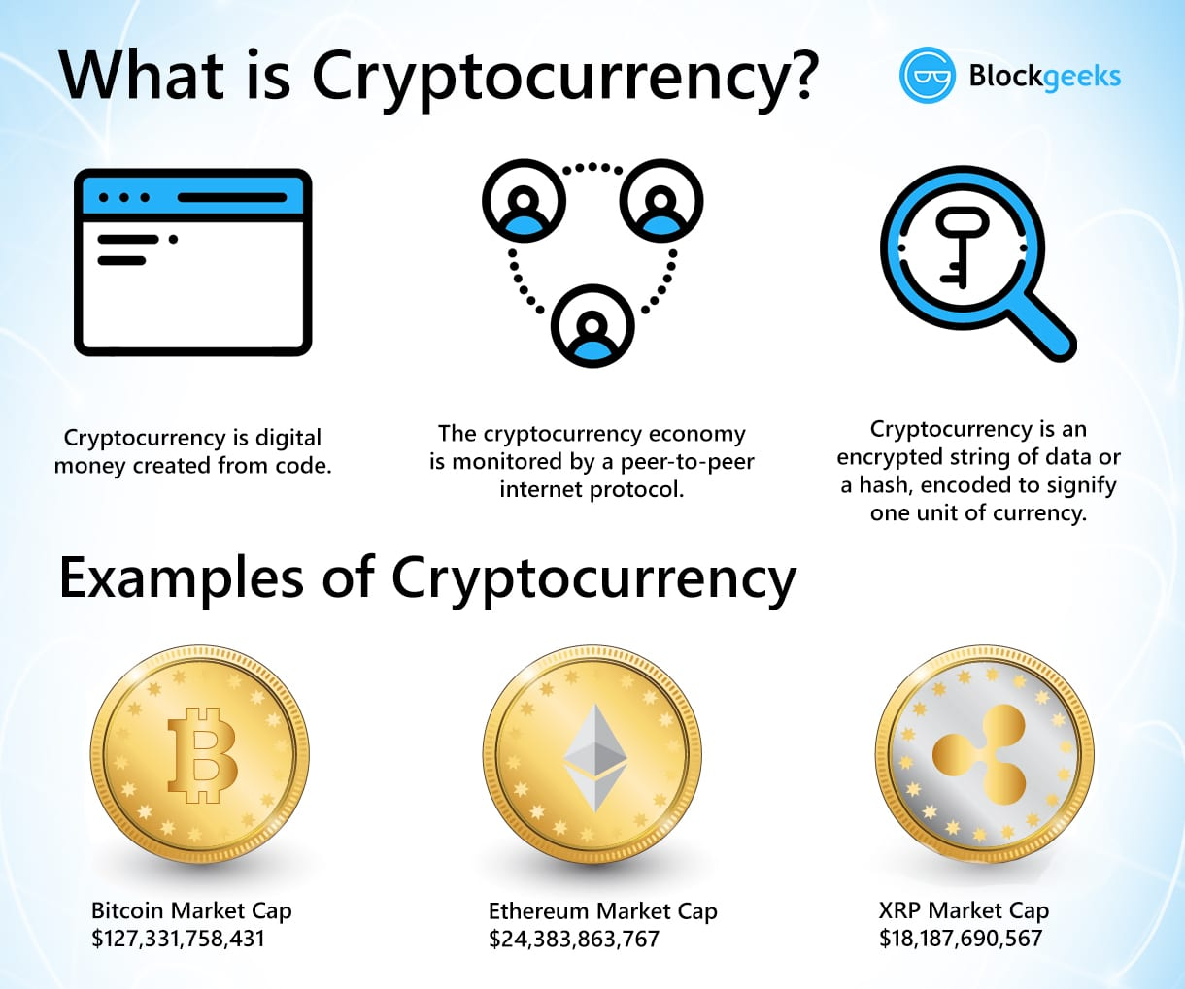
Cryptocurrency
Cryptocurrency is a form of payment that can be exchanged online for goods and services.
Many companies have issued their own currencies, often called tokens, and these can be traded specifically for the good or service that the company provides.
Cryptocurrencies work using a technology called blockchain.
Blockchain is a decentralized technology spread across many computers that manages and records transactions.
Part of the appeal of this technology is its security.

Slide 68
How many cryptocurrencies are there
More than 6,700 different cryptocurrencies are traded publicly, according to CoinMarketCap.com, a market research website.
The total value of all cryptocurrencies on September 2, 2020 was more than $370 billion, according to CoinMarketCap, and the total value of all bitcoins, the most popular digital currency, was pegged at about $210 billion.

Slide 69
Why are cryptocurrencies so popular
Cryptocurrencies appeal to their supporters for a variety of reasons. Here are some of the most popular:
Supporters see cryptocurrencies such as bitcoin as the currency of the future and are racing to buy them now, presumably before they become more valuable
Some supporters like the fact that cryptocurrency removes central banks from managing the money supply, since over time these banks tend to reduce the value of money via inflation
Other supporters like the technology behind cryptocurrencies, the blockchain, because it’s a decentralized processing and recording system and can be more secure than traditional payment systems

Slide 70
Are Cryptocurrency a good investment
For those who see cryptocurrencies such as bitcoin as the currency of the future, it should be noted that a currency needs stability so that merchants and consumers can determine what a fair price is for goods.
Bitcoin and other cryptocurrencies have been anything but stable through much of their history.
For example, while bitcoin traded at close to $20,000 in December 2017, its value then dropped to as low as about $3,200 a year later. In September 2020, it was trading above $11,000.
This price volatility creates a challenge.
If bitcoins might be worth a lot more in the future, people are less likely to spend and circulate them today, making them less viable as a currency.
Why spend a bitcoin when it could be worth three times the value next year?

Slide 71
How do I buy Cryptocurrency
While some cryptocurrencies, including bitcoin, are available for purchase with U.S. dollars, others require that you pay with bitcoin or another cryptocurrency.
To buy cryptocurrencies, you’ll need a “wallet,” an online app that can hold your currency.
Generally, you create an account on an exchange, and then you can transfer real money to buy cryptocurrencies such as Bitcoin or Ethereum.
Coinbase is one popular cryptocurrency trading exchange where you can create both a wallet and buy and sell bitcoin and other cryptocurrencies.
Also, a growing number of online brokers offer cryptocurrencies, such as eToro, Tradestation and Sofi Active Investing.

Slide 72
What is Bitcoin? (Introduction)
Bitcoin is software-based online payment system described by Satoshi Nakamoto in 2008. and introduced as open-source software in 2009.
Payments are recorded in a public ledger using its own unit of account (Bitcoin).
It is a form of digital currency (physical form is absent), created and held electronically.
It can be used to buy things electronically and in that sense it is no different than conventional dollars.
Bitcoin is commonly referred to as cryptocurrency and it can be divided into smaller unit called Satoshi (one hundred milionth of a BTC).

Slide 73
What is it based on? (coindesk.com)
System is runned by The Blockchain protocol
Bitcoin has several features that set it apart from fiat currencies:
It is decentralized
It is easy to set up and it is fast
It is anonymous
It is completely transparent
Transaction fees are miniscule
Transactions are irreversible

Slide 74
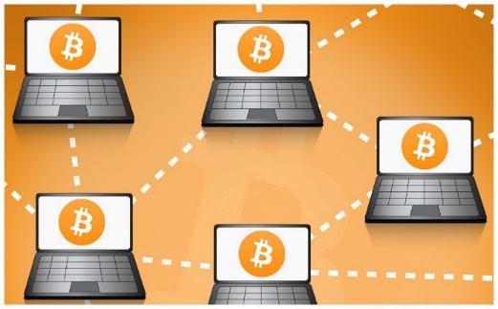
It’s decentralized
Base for the Blockchain protocol is a peer-to-peer system which means that there is no need for a third party.
Therefore, in theory, bitcoin network is not controled by central authority (fully decentralized monetary system).
Bitcoins are being created by a community of people that anyone can join.
In theory, there is no authority (financial institution) which can tinker with monetary policy and in that sense devalue or revalue Bitcoin currency.

Slide 75
It’s anonymus and transparent
Bitcoins are stored in wallet with digital credentials for your bitcoin holdings and allows you to access them.
Wallet uses public-key cryptography, in which two keys, one public and one private are generated.
Public key can be thought of as an account number or name and the private key, ownership credentials.
Bitcoin is transferred to the next owner when the next owner gives a public key and previous owner uses his private key to publish a record into system announcing that the ownership has changed to the new public key.
Bitcoin protocol stores details of every single transaction that occurred in the network in huge version of general ledger (Block chain).

Slide 76
Negligible fees and irreversible process
Bitcoin doesn’t charge fees for either national or international transfers.
Bitcoin is not the first private money, not the first digital currency, and not first currency based on cryptography, but it has been the first to rely on peer to peer network decentralization to avoid double spending.
Bitcoin protects against double spending by verifying each transaction added to the block chain to ensure that the inputs for the transaction had not previously already been spent.

Slide 77
What is Block Chain
Bitcoin is a network that runs on a protocol named “block chain”.
Blockchain, sometimes referred to as Distributed Ledger Technology (DLT)
A simple analogy for understanding blockchain technology is a Google Doc.
When we create a document and share it with a group of people, the document is distributed instead of copied or transferred.
This creates a decentralized distribution chain that gives everyone access to the document at the same time.
No one is locked out awaiting changes from another party, while all modifications to the doc are being recorded in real-time, making changes completely transparent.

Slide 78
How Does BlockChain Works?
Blockchain is an especially promising and revolutionary technology because it helps reduce risk, stamps out fraud and brings transparency in a scalable way for many uses.
Blockchain consists of three important concepts: blocks, nodes and miners.
Blocks:
Every chain consists of multiple blocks and each block has three basic elements:
The data in the block.
A 32-bit whole number called a nonce. The nonce is randomly generated when a block is created, which then generates a block header hash.
The hash is a 256-bit number wedded to the nonce. It must start with a huge number of zeroes (i.e., be extremely small).
When the first block of a chain is created, a nonce generates the cryptographic hash. The data in the block is considered signed and forever tied to the nonce and hash unless it is mined.

Slide 79
What is Nonce?
To explain it in simple words, a nonce is a combination of two words, “n” which means number and “once” which means one time.
Thus, nonce means using a number just once.
Technically nonce is a 32-bit arbitrary random number which can be used one time.
We all know that the mining process of Bitcoin involves Proof-of-work which means that the miners need to find hash which can solve the arithmetic puzzle.
Once they find the hash, they win the block.
As a miner, you need to find all the possible hash that will make you reach the target.
This random number can be anything between 0 and 2^32.
To make the mining process and rewards more authentic, the nonce is timestamped.
This is to ensure exact timeliness. It requires clock synchronization between organizations.

Slide 80
Explaining nonce in Blockchain
Let us say in a class the teacher gives a problem that students need to solve, the one who does it first wins an award.
315+?=319
Now let’s take this scenario away from the class and explain it with the help of Blockchain:
In the case of Blockchain, the miners need to find the right number which needs to be added to the block and solve the puzzle.
In this case, the students are the miners who are competing for the award.
4 is the nonce which can be used just once. It’s proof that you have found the answer for the same.
319 is the level of difficulty so that the teacher has control over the awards to be given.

Slide 81

How are Bitcoins created - Mining process
Miners use special software to solve math problems (Bitcoin algorithm), and upon completing the task they receive certain amount of coins.
They are created each time a user discovers new block (finds hash value).
Software is creating new units until it reaches amount of 21 million unites (currency with Finite Supply).
The rate of block creation is approximately consistant over time (6 per hour) with 50 % reduction every four years.
Halving (in theory) continues until 2110-2140 when 21 million BTC have been issued.

Slide 82
Importance of mining
Miners record all the transactions in the blockchain.
Recording a string of transactions is insignificant for a modern computer, but mining is difficult because Bitcoin's software makes the process artificially time-consuming.
Without the added difficulty, people could spoof transactions to enrich themselves or bankrupt other people.
They could log a fraudulent transaction in the blockchain and pile so many small transactions on top of it that untangling the fraud would become impossible.
By the same token, it would be easy to insert fraudulent transactions into past blocks.
The network would become a sprawling, spammy mess of competing ledgers, and bitcoin would be worthless.
Miners do not work to verify transactions by adding blocks to the distributed ledger purely out of a desire to see the Bitcoin network run smoothly; they are compensated for their work as well.

Slide 83
Halving
Miners are rewarded with Bitcoin for verifying blocks of transactions.
This reward is cut in half every 210,000 blocks mined, or, about every four years.
This event is called the halving or the "halvening.“
This process is designed so that rewards for Bitcoin mining will continue until about 2140.
Once all Bitcoin is mined from the code and all halvings are finished, the miners will remain incentivized by fees that they will charge network users.
The hope is that healthy competition will keep fees low.

Slide 84
How Hash work
The blockchain only contains validated transactions, which prevents fraudulent transactions and double spending of the currency.
The resulting encrypted value is a series of numbers and letters that do not resemble the original data and is called a hash.
Cryptocurrency mining involves working with this hash.
Hashing requires processing the data from a block through a mathematical function, which results in an output of a fixed length.
Using a fixed-length output increases security since anyone trying to decrypt the hash won’t be able to tell how long or short the input is simply by looking at the length of the output.
Solving the hash starts with the data available in the block header and is essentially solving a complex mathematical problem.
Each block header contains a version number, a timestamp, the hash used in the previous block, the hash of the Merkle Root, the nonce, and the target hash.

Slide 85
Cont….
The miner focuses on the nonce, a string of numbers.
This number is appended to the hashed contents of the previous block, which is then hashed.
If this new hash is less than or equal to the target hash, then it is accepted as the solution, the miner is given the reward, and the block is added to the blockchain.
Solving the hash requires the miner to determine which string to use as the nonce, which itself requires a significant amount of trial-and-error.
This is because the nonce is a random string.
It is highly unlikely that a miner will successfully come up with the correct nonce on the first try, meaning that the miner may potentially test a large number of nonce options before getting it right.
The greater the difficulty—a measure of how hard it is to create a hash that meets the requirement of the target hash—the longer it is likely to take to generate a solution.

Slide 86
An Example of a Hash
Hashing the word “hello” will produce an output that is the same length as the hash for “I am going to the store.”
The function used to generate the hash is deterministic, meaning that it will produce the same result each time the same input is used.
It also makes determining the input difficult (leading to mining), as well as makes small changes to the input result in an unrecognizable, entirely different hash.
Processing the hash functions needed to encrypt new blocks requires substantial computer processing power, which can be costly.
To entice individuals and companies, referred to as miners, to invest in the required technology, cryptocurrency networks reward them with both new cryptocurrency tokens and a transaction fee.
Miners are compensated only if they are the first to create a hash that meets the requirements outlined in the target hash.

Slide 87
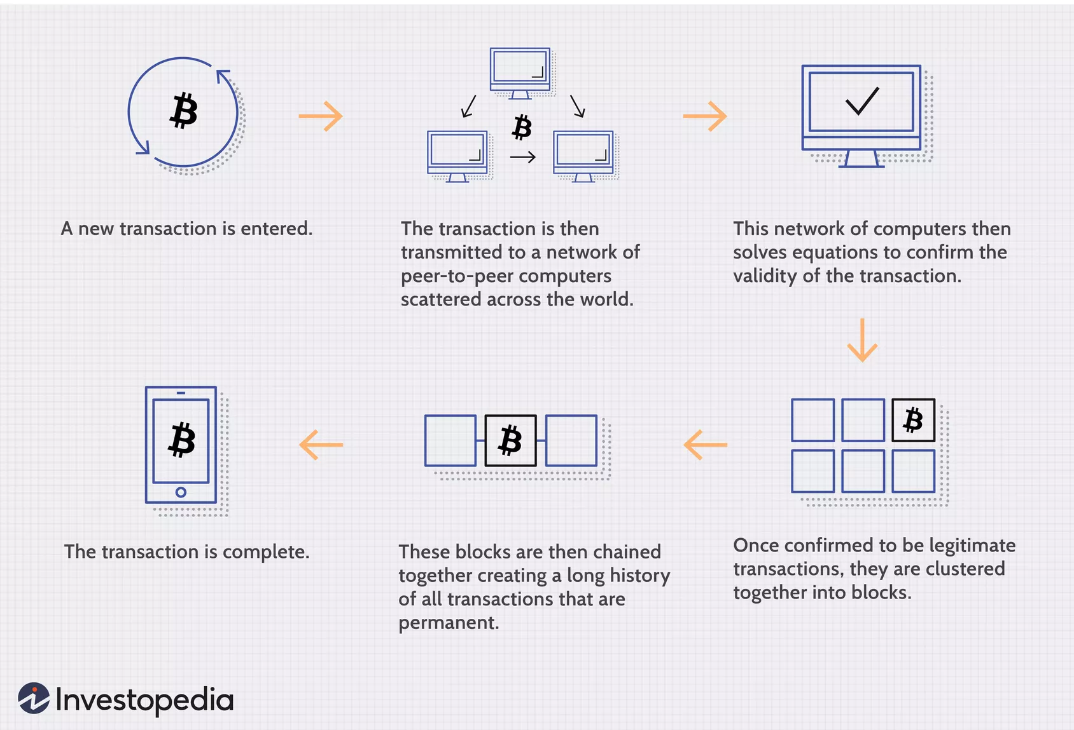
Transaction Process

Slide 88
How can one obtain Bitcoins?
Earn Bitcoins from mining
Earn Bitcoins by accepting them as a means of payment
Earn Bitcoins trough trading
Earn Bitcoins as a regular income
Earn Bitcoin from interest payments
Various ways (donations, gambling, getting tipped, completing tasks on websites...)

